Slide 1
Principle Component analysis

Slide 2
Principle Component analysis
Unsuperviserd ML technique
More dimension, more prone to noise and redundancy
Y_new
Y
Spread
X_new
Spread
X

Slide 3
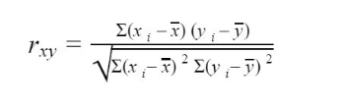
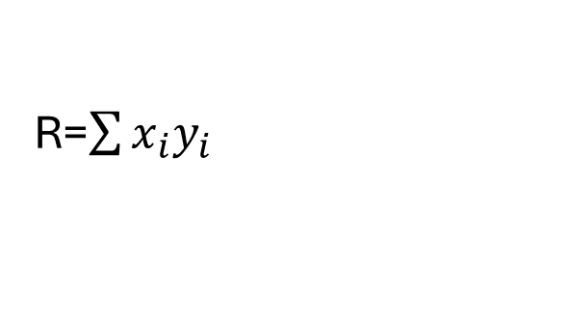
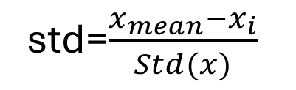

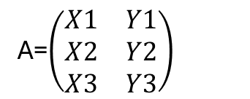

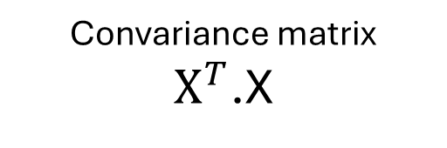
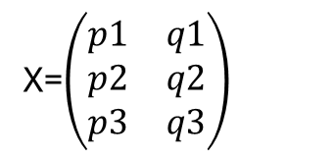
Principle Component analysis
We find the relation between axis, if so we don’t consider that.
We need to find the optimal basis (called Principle basis ) where there is no relation between axis
A=$\left(\begin{matrix}X1 & Y1 \\ X2 & Y2 \\ X3 & Y3\end{matrix}\right)$
X=$\left(\begin{matrix}p1 & q1 \\ p2 & q2 \\ p3 & q3\end{matrix}\right)$
(3,2) X (2,3)
$$\left(\begin{matrix}a & b \\ b & d\end{matrix}\right)$$
Square
Symetry
std=$\frac{x_{mean}−x_{i}}{Std(x)}$
Convariance matrix
${\text{X}}^{T}$.X
$$\left(\begin{matrix}s & 0 \\ 0 & t\end{matrix}\right)$$
R=$\sum{x_{i}y_{i}}$
Mean=0
Variance=1

Slide 4
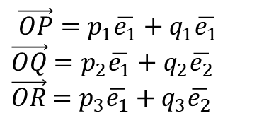
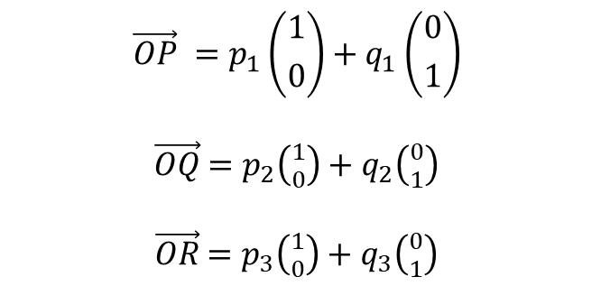
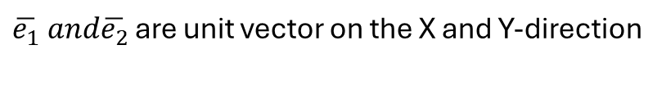
Principle Component analysis
Y
P
$$\vec{OP}=p_{1}\overline{e_{1}}+q_{1}\overline{e_{1}}$$
$\vec{OQ}$ $=p_{2}\overline{e_{1}}+q_{2}\overline{e_{2}}$
$\vec{OR}$ $=p_{3}\overline{e_{1}}+q_{3}\overline{e_{2}}$
$\overline{e_{1}} and\overline{e_{2}}$ are unit vector on the X and Y-direction
Q
R
Stadrize of component
O
X
$$\vec{OP} =p_{1}\left({1 \atop 0}\right)+q_{1}\left({0 \atop 1}\right)$$
$\vec{OQ}$ $=p_{2}\left({1 \atop 0}\right)+q_{2}\left({0 \atop 1}\right)$
$\vec{OR}$ $=p_{3}\left({1 \atop 0}\right)+q_{3}\left({0 \atop 1}\right)$
Y
L2
P
O
L1
X

Slide 5

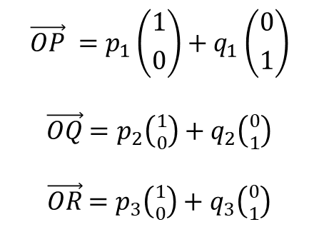

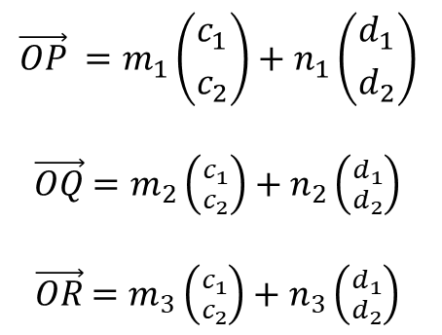

Principle Component analysis
Old basis
Y
$$\vec{OP} =p_{1}\left({1 \atop 0}\right)+q_{1}\left({0 \atop 1}\right)$$
$\vec{OQ}$ $=p_{2}\left({1 \atop 0}\right)+q_{2}\left({0 \atop 1}\right)$
$\vec{OR}$ $=p_{3}\left({1 \atop 0}\right)+q_{3}\left({0 \atop 1}\right)$
$$\overline{Y}$$
L2
P
$$\overline{X}$$
Component of the axis
O
L1
X
New basis
$$\left({c_{1} \atop c_{2}}\right)\left({d_{1} \atop d_{2}}\right)$$
$$\vec{OP} =m_{1}\left({c_{1} \atop c_{2}}\right)+n_{1}\left({d_{1} \atop d_{2}}\right)$$
$\vec{OQ}$ $=m_{2}\left({c_{1} \atop c_{2}}\right)+n_{2}\left({d_{1} \atop d_{2}}\right)$
$\vec{OR}$ $=m_{3}\left({c_{1} \atop c_{2}}\right)+n_{3}\left({d_{1} \atop d_{2}}\right)$
5

Slide 6
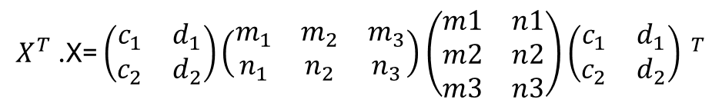

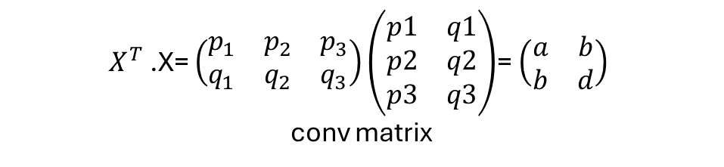

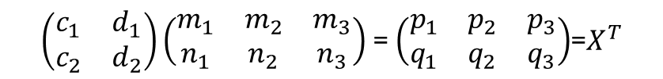
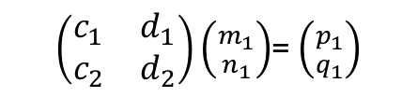


Principle Component analysis
$\vec{OP} =$ $\vec{OP}$
$m_{1}\left({c_{1} \atop c_{2}}\right)+n_{1}\left({d_{1} \atop d_{2}}\right)$ = $p_{1}\left({1 \atop 0}\right)+q_{1}\left({0 \atop 1}\right)$
$\left(\begin{matrix}c_{1} & d_{1} \\ c_{2} & d_{2}\end{matrix}\right)\left({m_{1} \atop n_{1}}\right)$= $\left(\begin{matrix}1 & 0 \\ 0 & 1\end{matrix}\right)\left({p_{1} \atop q_{1}}\right)$
Original data component
Original axis vector (Identity matrix)
New data component
New axis vector
$\left(\begin{matrix}c_{1} & d_{1} \\ c_{2} & d_{2}\end{matrix}\right)\left({m_{1} \atop n_{1}}\right)$= $\left({p_{1} \atop q_{1}}\right)$
For all data point
New basis
$\left(\begin{matrix}c_{1} & d_{1} \\ c_{2} & d_{2}\end{matrix}\right)\left(\begin{matrix}m_{1} & m_{2} & m_{3} \\ n_{1} & n_{2} & n_{3}\end{matrix}\right)$= $\left(\begin{matrix}p_{1} & p_{2} & p_{3} \\ q_{1} & q_{2} & q_{3}\end{matrix}\right)$=$X^{T}$
$X^{T}$.X= $\left(\begin{matrix}c_{1} & d_{1} \\ c_{2} & d_{2}\end{matrix}\right)\left(\begin{matrix}m_{1} & m_{2} & m_{3} \\ n_{1} & n_{2} & n_{3}\end{matrix}\right)$ $\left(\begin{matrix}m1 & n1 \\ m2 & n2 \\ m3 & n3\end{matrix}\right){\left(\begin{matrix}c_{1} & d_{1} \\ c_{2} & d_{2}\end{matrix}\right) }^{T}$
Old basis
Combining
$X^{T}$.X= $\left(\begin{matrix}p_{1} & p_{2} & p_{3} \\ q_{1} & q_{2} & q_{3}\end{matrix}\right)\left(\begin{matrix}p1 & q1 \\ p2 & q2 \\ p3 & q3\end{matrix}\right)$= $\left(\begin{matrix}a & b \\ b & d\end{matrix}\right)$
conv matrix
$$\left(\begin{matrix}a & b \\ b & d\end{matrix}\right)=\left(\begin{matrix}c_{1} & d_{1} \\ c_{2} & d_{2}\end{matrix}\right)\left(\begin{matrix}s & 0 \\ 0 & t\end{matrix}\right){\left(\begin{matrix}c_{1} & d_{1} \\ c_{2} & d_{2}\end{matrix}\right)}^{T}$$

Slide 7
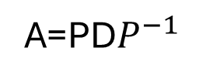

Principle Component analysis
Co-variance matrix of original (old) data
$$\left(\begin{matrix}a & b \\ b & d\end{matrix}\right)=\left(\begin{matrix}c_{1} & d_{1} \\ c_{2} & d_{2}\end{matrix}\right)\left(\begin{matrix}s & 0 \\ 0 & t\end{matrix}\right){\left(\begin{matrix}c_{1} & d_{1} \\ c_{2} & d_{2}\end{matrix}\right)}^{T}$$
Co-variance matrix of New data
Eigen vector
Eigen value
A=PD$P^{−1}$
Eigen vector
Symetry square matrix has special matrix that it eigen matrix (vector), let say Z then $Z^{T}=Z^{−1}$

Slide 8

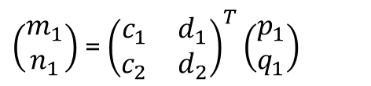
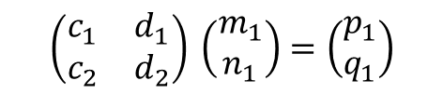
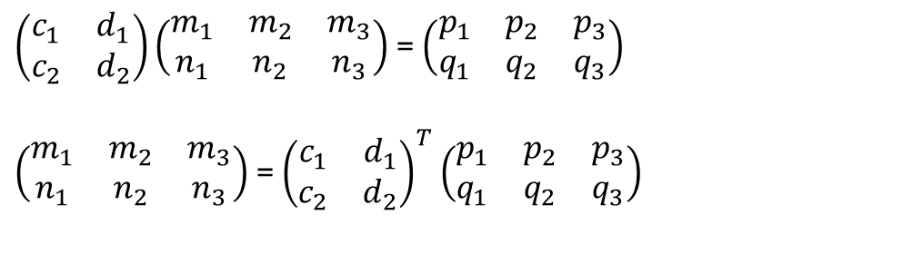



Principle Component analysis
For new component, we know:
$\left(\begin{matrix}c_{1} & d_{1} \\ c_{2} & d_{2}\end{matrix}\right)\left(\begin{matrix}m_{1} & m_{2} & m_{3} \\ n_{1} & n_{2} & n_{3}\end{matrix}\right)$= $\left(\begin{matrix}p_{1} & p_{2} & p_{3} \\ q_{1} & q_{2} & q_{3}\end{matrix}\right)$
$\left(\begin{matrix}m_{1} & m_{2} & m_{3} \\ n_{1} & n_{2} & n_{3}\end{matrix}\right)$= ${\left(\begin{matrix}c_{1} & d_{1} \\ c_{2} & d_{2}\end{matrix}\right)}^{T}$ $\left(\begin{matrix}p_{1} & p_{2} & p_{3} \\ q_{1} & q_{2} & q_{3}\end{matrix}\right)$
$\left(\begin{matrix}m_{1} \\ n_{1}\end{matrix}\right)$= ${\left(\begin{matrix}c_{1} & d_{1} \\ c_{2} & d_{2}\end{matrix}\right)}^{T}\left(\begin{matrix}p_{1} \\ q_{1}\end{matrix}\right)$
Relation:
Ax (standard basis)=> Dy(eigen basis)=>z(Eigen basis)(linear mapping)>q(standard basis)
Ax=PD${(P}^{−1}$x)
Ax=PD${(P}^{−1}$x)
New basis (co-ordinate change)
Ax=P{D${(P}^{−1}$x)}
Linear transformation
$${\left(\begin{matrix}c_{1} & d_{1} \\ c_{2} & d_{2}\end{matrix}\right)}^{ }\left(\begin{matrix}m_{1} \\ n_{1}\end{matrix}\right)=\left(\begin{matrix}p_{1} \\ q_{1}\end{matrix}\right)$$
Ax=P{D${(P}^{−1}$x)}
Again basis change to actual

Slide 9


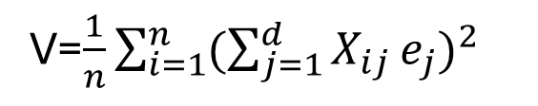

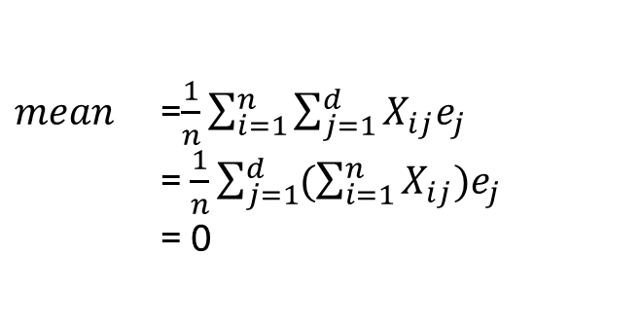
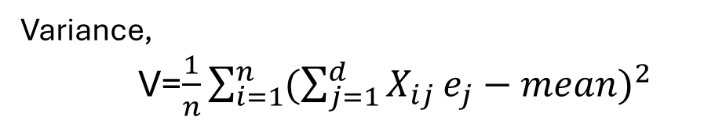
Principle Component analysis
How largest eigen value ensure largest variation of new data points (component)
Direction
Variance of projection of original data points of vector e.
$$\overline{Y}$$
Let original data is $X_{1},X_{2}$,….., $X_{n}$ with d dimensions
P
Q
R
Variance,
V=$\frac{1}{n}\sum_{i=1}^{n}{{(\sum_{j=1}^{d}{X_{ij}}e_{j}−mean)}^{2}}$
$$\overline{X}$$
V=$\frac{1}{n}\sum_{i=1}^{n}{{(\sum_{j=1}^{d}{X_{ij}}e_{j})}^{2}}$
O
We have to maximize the V and the constrain that, $e$should be unit length that means $\left|\left|e\right|\right|=1$
$mean$ =$\frac{1}{n}\sum_{i=1}^{n}{\sum_{j=1}^{d}{X_{ij}e_{j}}}$
= $\frac{1}{n}\sum_{j=1}^{d}{(\sum_{i=1}^{n}{X_{ij})e_{j}}}$
= 0

Slide 10
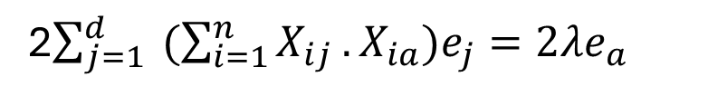
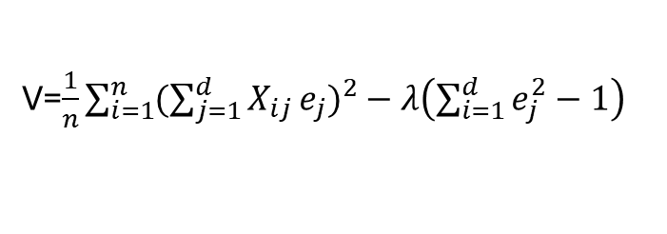
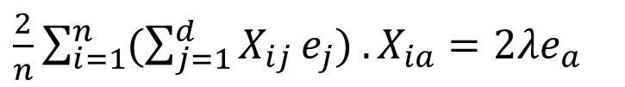
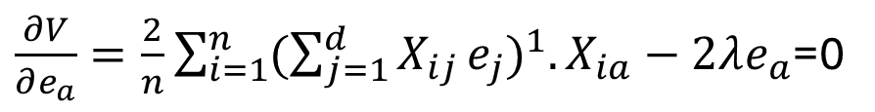

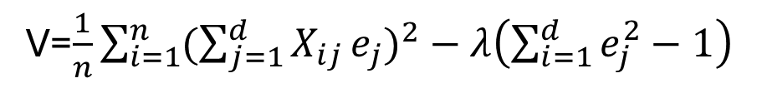
Principle Component analysis
We have to maximize the V and the constrain that, $e$should be unit length that means $\left|\left|e\right|\right|=1$. so we use lagrange multiplier ($λ$) :
So function is:
V=$\frac{1}{n}\sum_{i=1}^{n}{{(\sum_{j=1}^{d}{X_{ij}}e_{j})}^{2}}−λ\left(\sum_{i=1}^{d}{e_{j}^{2}}−1\right)$
Derivative should be zero for find maximum V,
V=$\frac{1}{n}\sum_{i=1}^{n}{{(\sum_{j=1}^{d}{X_{ij}}e_{j})}^{2}}−λ\left(\sum_{i=1}^{d}{e_{j}^{2}}−1\right)$
$\frac{∂V}{∂e_{a}}=\frac{2}{n}$ $\sum_{i=1}^{n}{{(\sum_{j=1}^{d}{X_{ij}}e_{j})}^{1}.X_{ia}}−2λe_{a}$=0
$e_{a}$ is a component of $e_{ }$
$\frac{2}{n}$ $\sum_{i=1}^{n}{{(\sum_{j=1}^{d}{X_{ij}}e_{j})}^{ }.X_{ia}}=2λe_{a}$
2$\sum_{j=1}^{d}{{ (\sum_{i=1}^{n}{X_{ij}}}^{ }.X_{ia})e_{j}}=2λe_{a}$
Convariance of (a,j)

Slide 11
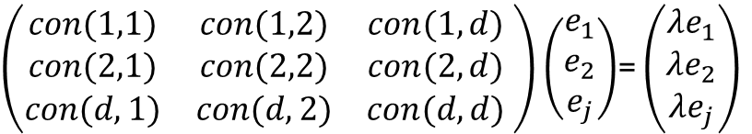
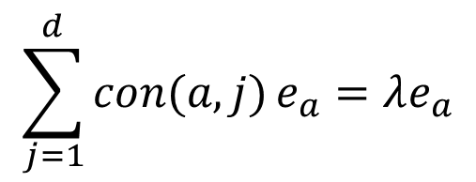
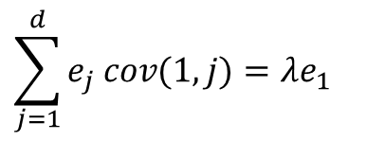




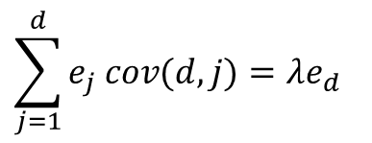
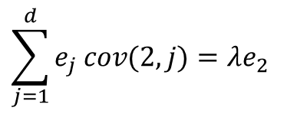
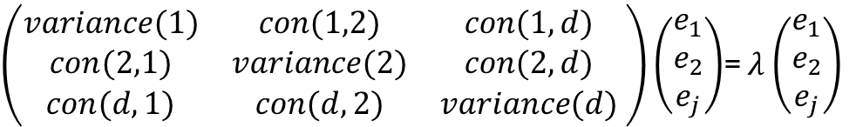
Principle Component analysis
$$\sum_{j=1}^{d}{con(a,j)}e_{a}=λe_{a}$$
$\left(\begin{matrix}con(1,1) & con(1,2) & con(1,d) \\ con(2,1) & con(2,2) & con(2,d) \\ con(d,1) & con(d,2) & con(d,d)\end{matrix} \right)$ $\left(\begin{matrix}e_{1} \\ e_{2} \\ e_{j}\end{matrix}\right)$= $\left(\begin{matrix}{λe}_{1} \\ {λe}_{2} \\ {λe}_{j}\end{matrix}\right)$
$$This hold for a=1,………….d$$
$$\sum_{j=1}^{d}{{e_{j}}^{ }cov(1,j)}=λe_{1}$$
$\left(\begin{matrix}variance(1) & con(1,2) & con(1,d) \\ con(2,1) & variance(2) & con(2,d) \\ con(d,1) & con(d,2) & variance(d)\end{matrix} \right)$ $\left(\begin{matrix}e_{1} \\ e_{2} \\ e_{j}\end{matrix}\right)$= $λ$ $\left(\begin{matrix}e_{1} \\ e_{2} \\ e_{j}\end{matrix}\right)$
$$\sum_{j=1}^{d}{{e_{j}}^{ }cov(2,j)}=λe_{2}$$
$$⋮$$
$$⋮$$
$$Ae=λe$$
$$\sum_{j=1}^{d}{{e_{j}}^{ }cov(d,j)}=λe_{d}$$
$$Convairanc matrix ×vector=scalar_value×vector$$
$$Matrix×eigen_{vector}=eigen_value×eigen_vector$$

Slide 12
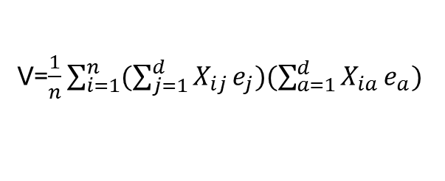


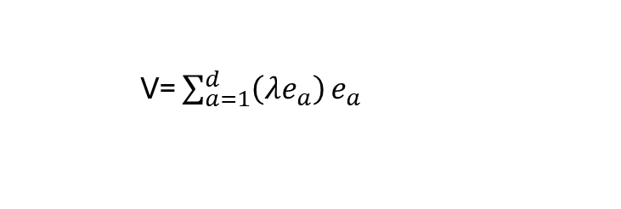
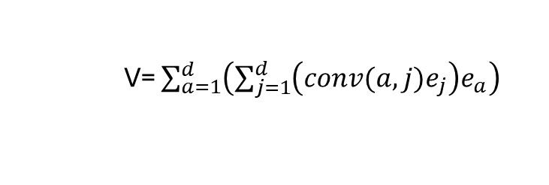
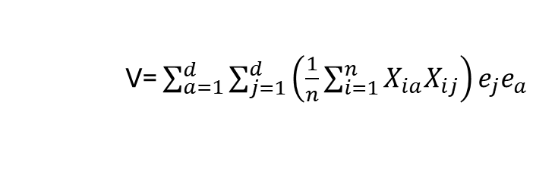
Variance of eigen vector
Principle Component analysis
Variance, V=$\frac{1}{n}\sum_{i=1}^{n}{{(\sum_{j=1}^{d}{X_{ij}}e_{j})}^{2}}$
V=$\frac{1}{n}\sum_{i=1}^{n}{{(\sum_{j=1}^{d}{X_{ij}}e_{j})(\sum_{a=1}^{d}{X_{ia}}e_{a})}^{ }}$
V= $\sum_{a=1}^{d}{\sum_{j=1}^{d}{\left(\frac{1}{n}\sum_{i=1}^{n}{X_{ia}X_{ij}}\right)e_{j}e_{a}}}$
V= $\sum_{a=1}^{d}{\left(\sum_{j=1}^{d}{\left(conv(a,j)e_{j}\right)e_{a}}\right)}$
V= $\sum_{a=1}^{d}{\left(λe_{a}\right)}e_{a}$
V= $\left(λ\right)$
Value

Slide 13
Standrize
Y
X
Mean=0
Variance=1

Slide 14

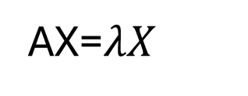

Eigen vector and Eigen value
AX=$λX$
Eigen vector
Y
Eigen value
$$λX$$
$$X$$
X
Mean=0
Variance=1

Slide 15
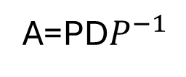
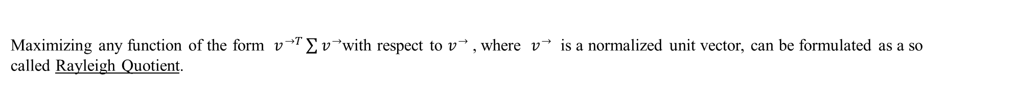
Eigen vector and Eigen value
Eigen vector
A=PD$P^{−1}$
Eigen vector
New_data= $Eigen vector$ $×$Old
Eigen vector which is linear transformation of initial basis.
$$Eigen value include the dot product which define the variance, hence low variance can be removed$$
If we define this vector as , then the projection of our data onto this vector is obtained as ,
and the variance of the projected data is .
Maximizing any function of the form $v^{→T}\sum{v^{→}}$with respect to $v^{→}$, where $v^{→}$ is a normalized unit vector, can be formulated as a so called Rayleigh Quotient.
The maximum of such a Rayleigh Quotient is obtained by setting vector equal to the largest eigenvector of matrix .

Slide 16
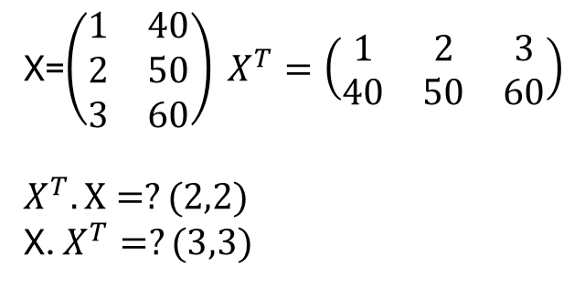
Eigen vector and Eigen value
X=$\left(\begin{matrix}1 & 40 \\ 2 & 50 \\ 3 & 60\end{matrix}\right) X^{T}=\left(\begin{matrix}1 & 2 & 3 \\ 40 & 50 & 60\end{matrix}\right)$
$$X^{T}.X=?(2,2)$$
X. $X^{T}=?(3,3)$

Slide 17


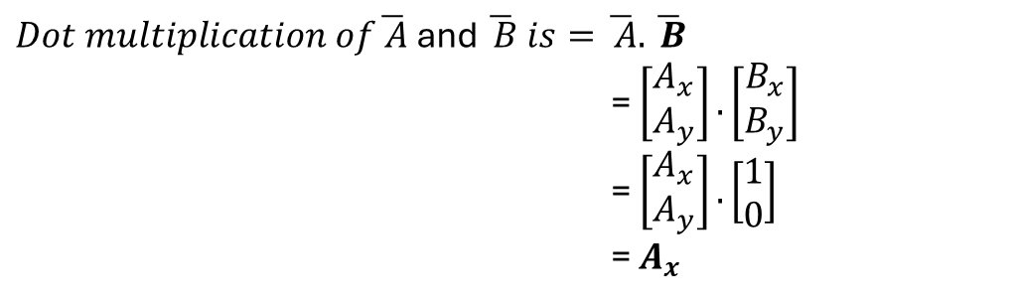


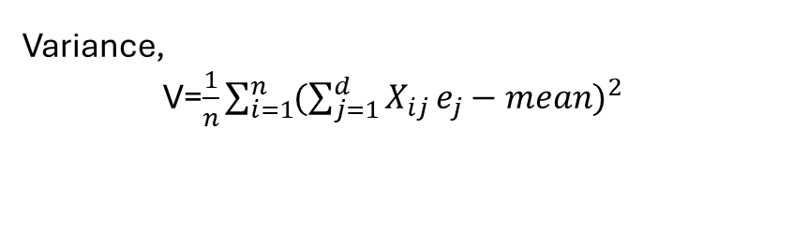

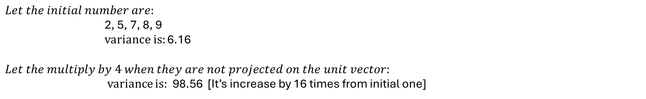
Eigen vector and Eigen value
Why the vector in which another vector is projected need to be unit?
$$Projection of vector\overline{ A} on vecor \overline{B} is\left|\left|A\right|\right|cosθ=A_{x}$$
$$Y$$
$Dot multiplication of\overline{ A}$ and $\overline{ B} is=\overline{ A}.\overline{ B}$
= $\left[\begin{matrix}A_{x} \\ A_{y}\end{matrix}\right].\left[\begin{matrix}B_{x} \\ B_{y}\end{matrix}\right]$
= $\left[\begin{matrix}A_{x} \\ A_{y}\end{matrix}\right].\left[\begin{matrix}1 \\ 0\end{matrix}\right]$
= $A_{x}$
$$\overline{A}$$
$$θ$$
$$Let the initial number are:$$
2, 5, 7, 8, 9
variance is: 6.16
$$Let the multiply by 4 when they are not projected on the unit vector:$$
variance is: 98.56 [It’s increase by 16 times from initial one]
O
$$\overline{B}$$
C
$$X$$
Variance,
V=$\frac{1}{n}\sum_{i=1}^{n}{{(\sum_{j=1}^{d}{X_{ij}}e_{j}−mean)}^{2}}$

Slide 18

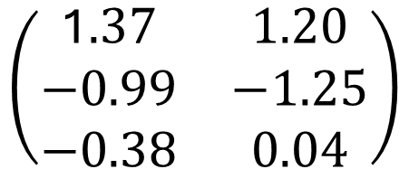

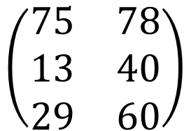

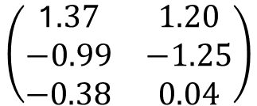


Priniciple component analysis
Height
Age
$$\left(\begin{matrix}75 & 78 \\ 13 & 40 \\ 29 & 60\end{matrix}\right)$$
$$\left(\begin{matrix}\text{1}.37 & \text{1.20} \\ −0.99 & −1.25 \\ \text{−0.38} & \text{0.04}\end{matrix}\right)$$
$$\left(\begin{matrix}\text{1}.37 & \text{1.20} \\ −0.99 & −1.25 \\ \text{−0.38} & \text{0.04}\end{matrix}\right)$$
Standrize
the data
$$\left(\begin{matrix}\text{1.37} & −0.99 & −0.38 \\ 1.20 & −1.25 & 0.04\end{matrix}\right)$$
Co-variance= $X^{T}.X$
A=(height, Age)
X
$$\left(\begin{matrix}3.0014 & 2.8663 \\ 2.8863 & 3.0041\end{matrix}\right)$$
$$\left(\begin{matrix}5.9371 & 0 \\ 0 & 0.0671\end{matrix}\right)$$
$$\left(\begin{matrix}0.9767 & −0.9779 \\ 1 & 1\end{matrix}\right)$$
Eigen value
Eigen vector

Slide 19


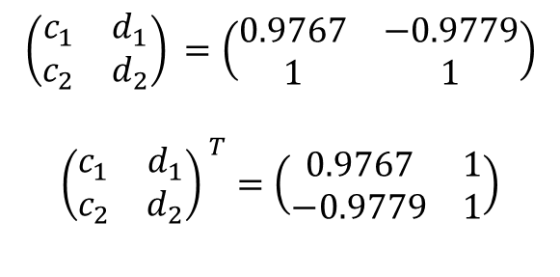
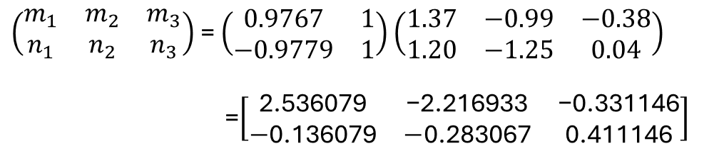
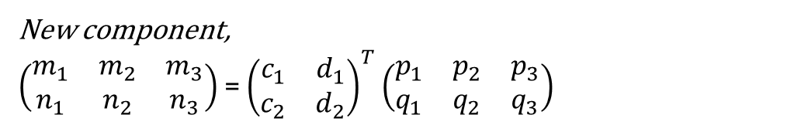
Priniciple component analysis
$$\left(\begin{matrix}5.9371 & 0 \\ 0 & 0.0671\end{matrix}\right)$$
$$\left(\begin{matrix}0.9767 & −0.9779 \\ 1 & 1\end{matrix}\right)$$
New component,
$\left(\begin{matrix}m_{1} & m_{2} & m_{3} \\ n_{1} & n_{2} & n_{3}\end{matrix}\right)$= ${\left(\begin{matrix}c_{1} & d_{1} \\ c_{2} & d_{2}\end{matrix}\right)}^{T}$ $\left(\begin{matrix}p_{1} & p_{2} & p_{3} \\ q_{1} & q_{2} & q_{3}\end{matrix}\right)$
Eigen value
Eigen vector
$${\left(\begin{matrix}c_{1} & d_{1} \\ c_{2} & d_{2}\end{matrix}\right)}^{ }=\left(\begin{matrix}0.9767 & −0.9779 \\ 1 & 1\end{matrix}\right)$$
$${\left(\begin{matrix}c_{1} & d_{1} \\ c_{2} & d_{2}\end{matrix}\right)}^{ T}=\left(\begin{matrix}0.9767 & 1 \\ −0.9779 & 1\end{matrix}\right)$$
$\left(\begin{matrix}m_{1} & m_{2} & m_{3} \\ n_{1} & n_{2} & n_{3}\end{matrix}\right)$= $\left(\begin{matrix}0.9767 & 1 \\ −0.9779 & 1\end{matrix}\right)$ $\left(\begin{matrix}\text{1.37} & −0.99 & −0.38 \\ 1.20 & −1.25 & 0.04\end{matrix}\right)$
=$\left[\begin{matrix}\text{2.536079} & \text{−2.216933} & \text{−0.331146} \\ −\text{0.136079} & −\text{0.283067} & \text{0.411146}\end{matrix}\right]$

Slide 20


Singular value decomposition
Using eigen vector to make the matrix diagonal.
Diagonal matrix easy to calculation , like multiplication and addition
When a matrix is not square or symmetry !
Make a single matrix to bunch of matrix (decomposition) to make calculation easier
Diagonal matrix
$A_{mn}$= $U_{mm} S_{mn} V_{nn}^{T}$
$$A=PDP_{ }^{−1}$$

Slide 21





Singular value decomposition
$$A^{t}A=VMV^{t}$$
= $VS^{t}SV^{t}$
= $VS^{t}I SV^{t}$
= $VS^{t}U^{t}USV^{t}$
= $(VS^{t}U^{t})(USV^{t})$
=${(USV^{t})}^{t}$ $(USV^{t})$
${AA}^{t}$= $VMV^{t}$
$A^{t}A$= $UMU^{t}$
$M=S^{t}S$
$${(A}^{t}A)\overline{u}=k\overline{u}$$
$${(AA}^{t})\overline{v}=c\overline{v}$$
Now:
$${AA}^{t}A\overline{v}=Ac\overline{v}$$
(${AA}^{t}).\left(A\overline{v}\right)=c\left(A\overline{v}\right)$
$\overline{u}$= $A\overline{v}$, c=k
Singular value matrix
A= $USV^{t}$
Eigen vector from
$A^{t}A$= $UMU^{t}$
Eigen vector from
${AA}^{t}$= $VMV^{t}$

Slide 22



Priniciple component analysis
Height
Age
$$\left(\begin{matrix}75 & 78 \\ 13 & 40 \\ 29 & 60\end{matrix}\right)$$
What happen with out standrization
What happen when takes row
X.$X^{T}$
$$X=\left(\begin{matrix}\text{1}.37 & \text{1.20} \\ −0.99 & −1.25 \\ \text{−0.38} & \text{0.04}\end{matrix}\right)$$
$$X.X^{T}=\left(\begin{matrix}3.269 & −2.8563 & −0.4726 \\ −2.8563 & 2.5426 & \text{0.3262} \\ −0.4726 & \text{0.3262} & 0.146\end{matrix}\right)$$

Slide 23

Eigen vector and Eigen value

Slide 24
Random variable
No probability for individuals outcome but outcome contrained in a range

Slide 25
Practical

Slide 26
Principle component analysis
Eignen values
Channel_0: [584.18 131.47 87.74 ... -0. -0. -0. ] (1366,)
Channel_1: [589.86 132.88 113.45 ... -0. -0. -0. ] (1366,)
Channel_2: [662.27 209.54 103.92 ... -0. -0. -0. ] (1366,)
Variance of new component
Channel_0: [583.42 131.29 87.62 ... 0. 0. 0. ] (1366,)
Channel_1: [589.09 132.71 113.3 ... 0. 0. 0. ] (1366,)
Channel_2: [661.41 209.27 103.78 ... 0. 0. 0. ] (1366,)

Slide 27


Principle component analysis
$\left(\begin{matrix}c_{1} & d_{1} \\ c_{2} & d_{2}\end{matrix}\right)\left(\begin{matrix}m_{1} & m_{2} & m_{3} \\ n_{1} & n_{2} & n_{3}\end{matrix}\right)$= $\left(\begin{matrix}p_{1} & p_{2} & p_{3} \\ q_{1} & q_{2} & q_{3}\end{matrix}\right)$=$X^{T}$
Eigen vector matrix * New component = Old component
Old component = $\left(\begin{matrix}p_{1} & p_{2} & p_{3} \\ q_{1} & q_{2} & q_{3}\end{matrix}\right)$=$X^{T}$
[[ 1.54826338 1.52561088 1.5281453 ... 1.25133104 1.29406325, 1.31761769]
[ 1.54826338 1.52561088 1.5281453 ... 1.25133104 1.29406325, 1.36672503]
[ 1.52321221 1.51312213 1.50318909 ... 1.30061044 1.26961934, 1.31761769]
Eigen vector matrix * New component:
[[ 1.54826338 1.52561088 1.5281453 ... 1.25133104 1.29406325, 1.31761769]
[ 1.54826338 1.52561088 1.5281453 ... 1.25133104 1.29406325, 1.36672503]
[ 1.52321221 1.51312213 1.50318909 ... 1.30061044 1.26961934, 1.31761769]

Slide 28

3
4
p
1
8
4
OP vector
o
3
origin
$\left(\begin{matrix}c_{1} & d_{1} \\ c_{2} & d_{2}\end{matrix}\right)\left(\begin{matrix}m_{1} & m_{2} & m_{3} \\ n_{1} & n_{2} & n_{3}\end{matrix}\right)$= $\left(\begin{matrix}p_{1} & p_{2} & p_{3} \\ q_{1} & q_{2} & q_{3}\end{matrix}\right)$=$X^{T}$
Eigen vector matrix * New component = Old component

Slide 29


Principle component analysis
Why we need eigen value and eigen matrix?;
Easy calculation
Eigen vector
$$A=PDP_{ }^{−1}$$
Diagonal metrics (Eigen value)
$$A^{n}=PDP_{ }^{−1}.PDP_{ }^{−1}……...PDP_{ }^{−1}$$
$$A^{n}=PDID…….IDP_{ }^{−1}$$
$$A^{n}={PD^{n}P}_{ }^{−1}$$

Slide 30

Principle component analysis
1. Why we need eigen value and eigen matrix?
Easy calculation
Eigen vector
$$D=PAP_{ }^{−1}$$
Diagonal metrics (Eigen value)
New component
New component
1
2
3
4
5
.
7
1
2
3
4
5

Slide 31



Principle Component analysis
Y
$\overline{e_{1}} and\overline{e_{2}}$ are unit vector on the X and Y-direction
$$A=\left(\begin{matrix}\vec{OP} \\ \vec{OQ}\end{matrix}\right)=\left(\begin{matrix}x_{1} & y_{1} \\ x_{2} & y_{2}\end{matrix}\right)$$
P
Q
R
$$\vec{OP}=x_{1}\overline{e_{1}}+y\overline{e_{1}}$$
$\vec{OQ}$ $=x_{2}\overline{e_{1}}+y_{2}\overline{e_{2}}$
O
X
Stadrize of component
Y
L2
P
$$\vec{OP} =x_{1}\left({1 \atop 0}\right)+y_{1}\left({0 \atop 1}\right)$$
$$\vec{OQ} =x_{2}\left({1 \atop 0}\right)+y_{2}\left({0 \atop 1}\right)$$
O
L1
X

Slide 32




Principle Component analysis
Old basis
$$\left({d_{1} \atop d_{2}}\right)$$
Y
$$\vec{OP} =x_{1}\left({1 \atop 0}\right)+y_{1}\left({0 \atop 1}\right)$$
$\vec{OQ}$ $=x_{2}\left({1 \atop 0}\right)+y_{2}\left({0 \atop 1}\right)$
$$\overline{Y}$$
L2
P
$$\left({c_{1} \atop c_{2}}\right)$$
$$\overline{X}$$
Component of the axis
O
L1
X
New basis
$$\vec{OP} =m_{1}\left({c_{1} \atop c_{2}}\right)+n_{1}\left({d_{1} \atop d_{2}}\right)$$
$\vec{OQ}$ $=m_{2}\left({c_{1} \atop c_{2}}\right)+n_{2}\left({d_{1} \atop d_{2}}\right)$
32

Slide 33





Principle Component analysis
Y
$$\overline{Y}$$
L2
P
$\vec{OP} =$ $\vec{OP}$
$m_{1}\left({c_{1} \atop c_{2}}\right)+n_{1}\left({d_{1} \atop d_{2}}\right)$ = $x_{1}\left({1 \atop 0}\right)+y_{1}\left({0 \atop 1}\right)$
$$\overline{X}$$
$\left(\begin{matrix}c_{1} & d_{1} \\ c_{2} & d_{2}\end{matrix}\right)\left({m_{1} \atop n_{1}}\right)$= $\left(\begin{matrix}1 & 0 \\ 0 & 1\end{matrix}\right)\left({x_{1} \atop y_{1}}\right)$
O
L1
X
Original data component
Original axis vector (Identity matrix)
New data component
New axis vector
$\left(\begin{matrix}c_{1} & d_{1} \\ c_{2} & d_{2}\end{matrix}\right)\left({m_{1} \atop n_{1}}\right)$= $\left({x_{1} \atop y_{1}}\right)$
For all data point
$\left(\begin{matrix}c_{1} & d_{1} \\ c_{2} & d_{2}\end{matrix}\right)\left(\begin{matrix}m_{1} & m_{2} \\ n_{1} & n_{2}\end{matrix}\right)=\left(\begin{matrix}x_{1} & x_{2} \\ y_{1} & y_{2}\end{matrix}\right)$=$A^{T}$

Slide 34







Principle Component analysis
For all data point
$$A^{T}=\left(\begin{matrix}x_{1} & x_{2} \\ y_{1} & y_{2}\end{matrix}\right)=\left(\begin{matrix}c_{1} & d_{1} \\ c_{2} & d_{2}\end{matrix}\right)\left(\begin{matrix}m_{1} & m_{2} \\ n_{1} & n_{2}\end{matrix}\right)$$
$\left(\begin{matrix}x_{1} & y_{1} \\ x_{2} & y_{2}\end{matrix}\right)=$ $\left(\begin{matrix}m_{1} & n_{1} \\ m_{2} & n_{2}\end{matrix}\right)$ $\left(\begin{matrix}c_{1} & c_{2} \\ d_{1} & d_{2}\end{matrix}\right)$
$A=$ $\left(\begin{matrix}x_{1} & y_{1} \\ x_{2} & y_{2}\end{matrix}\right)=$ $\left(\begin{matrix}m_{1} & n_{1} \\ m_{2} & n_{2}\end{matrix}\right)$ $\left(\begin{matrix}c_{1} & c_{2} \\ d_{1} & d_{2}\end{matrix}\right)$
A= new_Copnent * P
$\left(\begin{matrix}x_{1} & y_{1} \\ x_{2} & y_{2}\end{matrix}\right){\left(\begin{matrix}c_{1} & c_{2} \\ d_{1} & d_{2}\end{matrix}\right)}^{−1}=$ $\left(\begin{matrix}m_{1} & n_{1} \\ m_{2} & n_{2}\end{matrix}\right)$
A=PD$P^{−1}$
D= $P^{−1}AP$
New basis
$A^{T}.A=\left(\begin{matrix}c_{1} & d_{1} \\ c_{2} & d_{2}\end{matrix}\right)$ $\left(\begin{matrix}m_{1} & m_{2} \\ n_{1} & n_{2}\end{matrix}\right)$ $\left(\begin{matrix}m_{1} & n_{1} \\ m_{2} & n_{2}\end{matrix}\right) {\left(\begin{matrix}c_{1} & d_{1} \\ c_{2} & d_{2}\end{matrix}\right) }^{−1}$
Old basis
Combining
$\left(\begin{matrix}c_{1} & d_{1} \\ c_{2} & d_{2}\end{matrix}\right)\left(\begin{matrix}m_{1} & m_{2} \\ n_{1} & n_{2}\end{matrix}\right)=\left(\begin{matrix}x_{1} & x_{2} \\ y_{1} & y_{2}\end{matrix}\right)$=$A^{T}$
$$\left(\begin{matrix}a & b \\ b & d\end{matrix}\right)=\left(\begin{matrix}c_{1} & d_{1} \\ c_{2} & d_{2}\end{matrix}\right)\left(\begin{matrix}s & 0 \\ 0 & t\end{matrix}\right){\left(\begin{matrix}c_{1} & d_{1} \\ c_{2} & d_{2}\end{matrix}\right)}^{−1}$$

Slide 35



Principle Component analysis
$A=$ $\left(\begin{matrix}x_{1} & y_{1} \\ x_{2} & y_{2}\end{matrix}\right)=$ $\left(\begin{matrix}m_{1} & n_{1} \\ m_{2} & n_{2}\end{matrix}\right)$ $\left(\begin{matrix}c_{1} & c_{2} \\ d_{1} & d_{2}\end{matrix}\right)$
A= new_Copnent * P
new_component= $AP^{−1}$
$$\left(\begin{matrix}a & b \\ b & d\end{matrix}\right)=\left(\begin{matrix}c_{1} & d_{1} \\ c_{2} & d_{2}\end{matrix}\right)\left(\begin{matrix}s & 0 \\ 0 & t\end{matrix}\right){\left(\begin{matrix}c_{1} & d_{1} \\ c_{2} & d_{2}\end{matrix}\right)}^{−1}$$
A=PD$P^{−1}$
D= $P^{−1}AP$
PD=AP

Slide 36
Principle Component analysis
A = np.array(
[[4, 2, 1],
[0, 3, -1],
[0, 0, 2]]
)
[[ 1. -0.90 -0.73]
P= [ 0. 0.40 0.49]
[ 0. 0. 0 0.49]]
[[4. 0. 0.]
D= [0. 3. 0.]
[0. 0. 2.]]
[[ 1. 2. -0.5 ]
P= [ 0. 2.2 -2.2]
[ 0. 0. 2.06]]

Slide 37

Principle Component analysis
New component
New component
New component,
$\left(\begin{matrix}m_{1} & m_{2} & m_{3} \\ n_{1} & n_{2} & n_{3}\end{matrix}\right)$= ${\left(\begin{matrix}c_{1} & d_{1} \\ c_{2} & d_{2}\end{matrix}\right)}^{T}$ $\left(\begin{matrix}p_{1} & p_{2} & p_{3} \\ q_{1} & q_{2} & q_{3}\end{matrix}\right)$
1
2
3
4
5
.
7
1
2
3
4
5

